Slide 1




Evaluating the Efficiency and Accuracy of GPT-4 in Analyzing Pharmaceutical Annual Reports: A Comparative Study with Manual Review
Presentation by: Misan Ayomike
Principle Investigator: Dr. Pietro Veronesi

Slide 2

Main Theme
Improve pharma companies' operational efficiency
Determine AI's speed and accuracy

Slide 3






Research Agenda
Methodology
Results
Relevance
Limitations
Future research
Conclusion

Slide 4

How fast, accurate and reliable is AI—more specifically Chat GPT's most recent update (GPT-4o)—in reviewing financial reports?

Slide 5
Methodology – Numerical Data Collection
Manual Collection
    The Drugs@FDA database
    20 pharmaceutical companies
    Manually reviewed 2023 annual reports
    Excel entries
AI Collection
  Utilized Chat GPT-4o
    Advanced AI language model
    Widely used for various applications
    6 questions
    Individual document uploads

Slide 6

Methodology: Prompt Questions
Total Revenue/Net Sales
Operating Profits/loss
Earnings Per Share (EPS)
Research and Development (R&D)
Total Employees
Operating Margin %

Slide 7

Methodology: Data Analysis Procedure
Speed ratio
Total Errors
Average, Median and Standard deviation of Errors
k-Percentiles of error calculation
Absolute k-Percentiles of error calculation

Slide 8
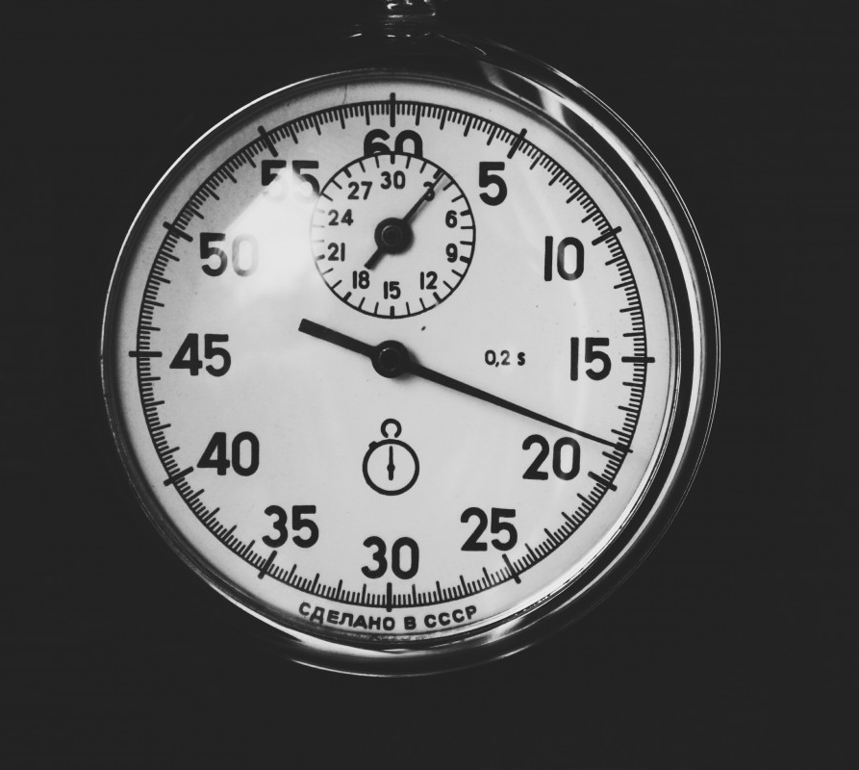
Results: Speed Analysis
8hrs 30mins approx. spent manually searching
1hr 30mins approx. spent with GPT-4o
Chat GPT is 5.67 times faster

Slide 9
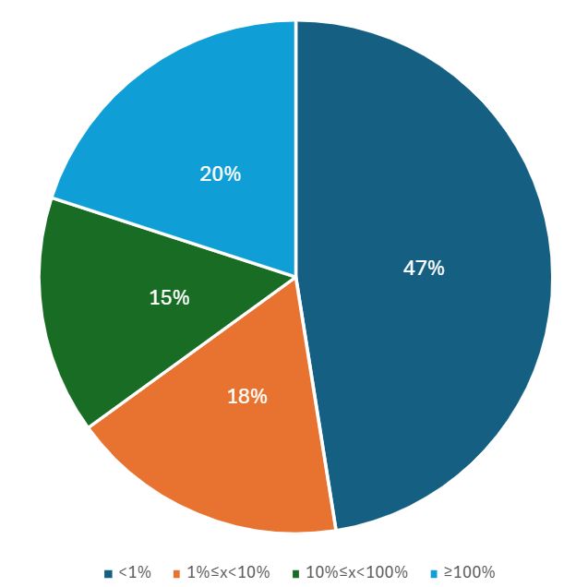
Result: Total Error Analysis
Error Occurrences
(Total % value)
120 observations for manual and ai data sets each (240 total)
40 errors:
    <1% = 19 errors
    1%≤x<10% = 7 errors
    10%≤x<100% = 6 errors
    ≥100% = 8 errors

Slide 10
Results: Absolute Error Rates
Total average error rate (absolute): 11.78%
Total median error rate of total dataset (absolute): 0.00%
Total standard Deviation of total dataset (absolute): 41.34%

Slide 11
Results: Absolute Error Rates

Slide 12
Results: Error Rates
Total average Error rate: -10.60%
Median Error rate of total dataset: 0.00%
Standard Deviation of total dataset: 41.66%

Slide 13
Results: Error rates

Slide 14
Results: Possibility of error (occurrences)
67th percentile absolute p.o.e.
    >1% = 83rd percentile upwards
    86% major accuracy (>5% = 87th to max)

Slide 15
Results: Possibility of error (occurrences)
(left) 21st percentile p.o.e. (< value)
    <-1% = min to12th percentile
    91% major accuracy (>5% = min to 9th)
(right) 87th percentile p.o.e. (> value)
    >1% = 94th percentile upwards
    96% major accuracy (>5% = 97th to max)

Slide 16
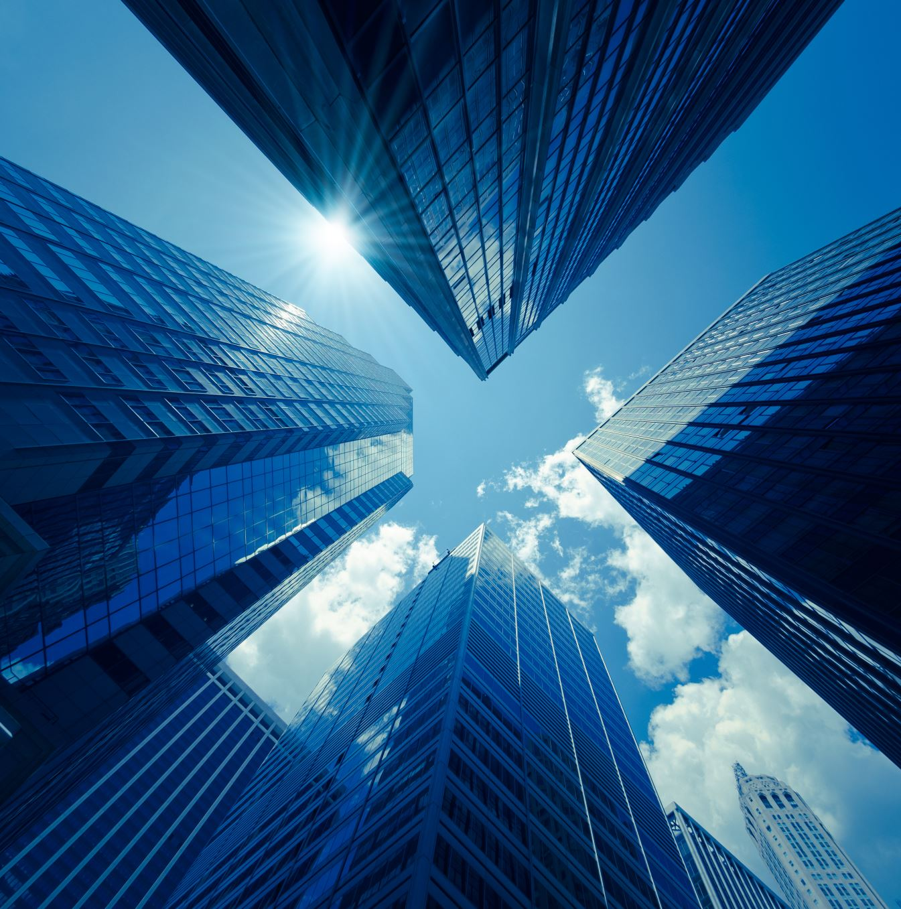
Relevance
Promotes drug discovery and patient care
Inspires research for enhanced data management
Provides valuable feedback for AI developers

Slide 17
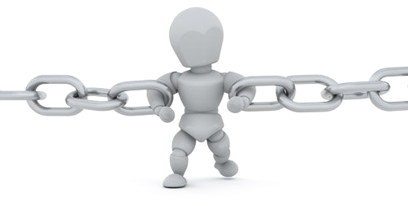
Limitations
Scope of data
    20 companies, 6 questions
Comparative Analysis Constraints
    Does not account for context-specific factors influencing data accuracy

Slide 18
Conclusion
Significant time savings.
Absolute accuracy rate is 86%
Human and AI works best

Slide 19
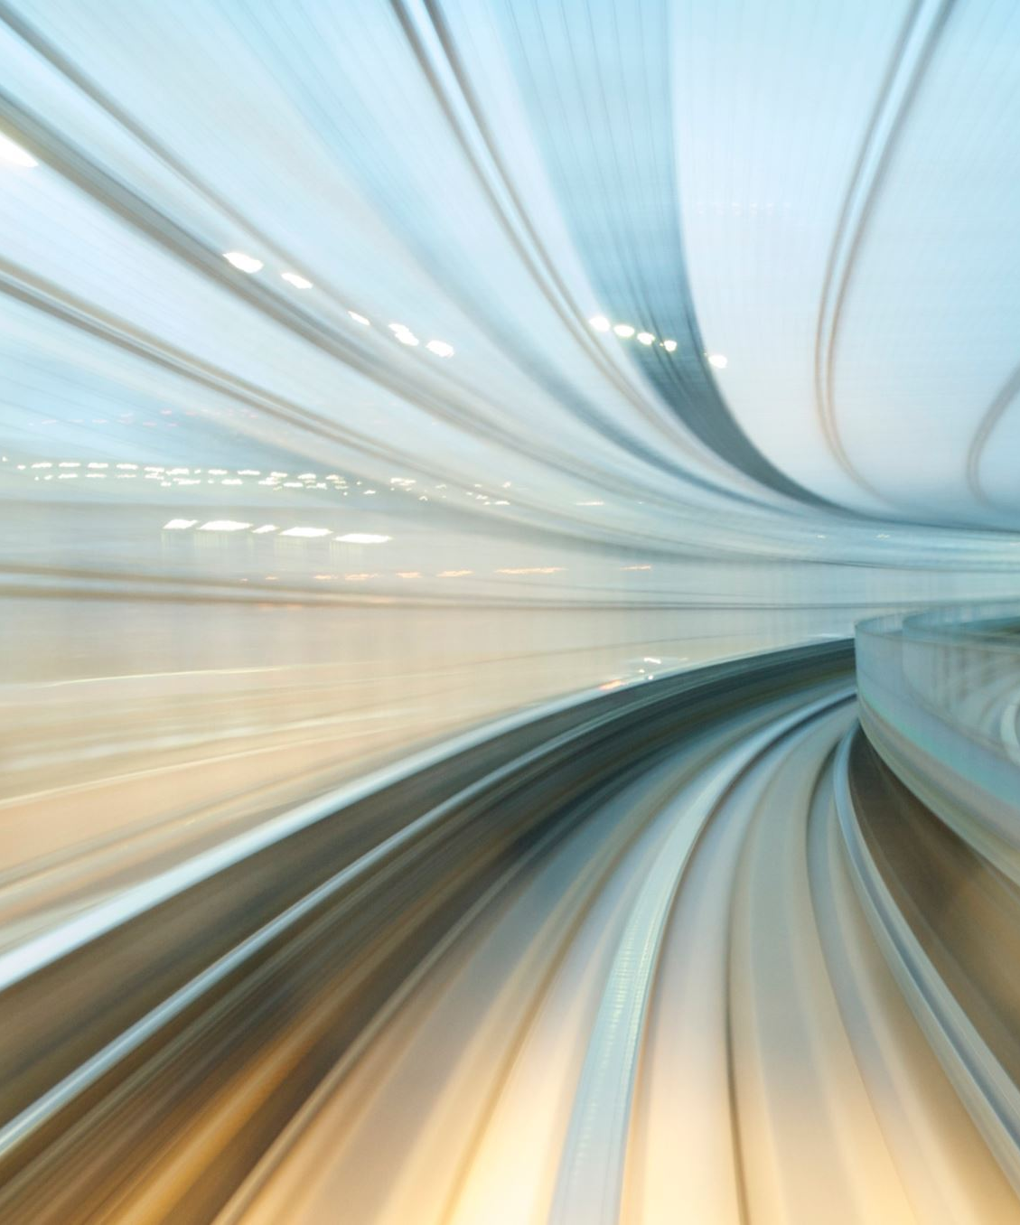
Future Directions
Cross-Disciplinary Applications.
    Other Industries
    Non-Financial Reports or broader industry analysis
Comparative AI Models.
    (e.g., GPT-5, BERT, T5)
Advanced statistical and analytical tools.

Slide 20

Acknowledgments
P.I: Dr. Pietro Veronesi
T.A: Bruno Maguida
A.D: Dr. Victoria Flores
C.D: Mrs. Christine Routzahn
Interviewer: Mr. Calvin Baker
Recommenders:
Prof. Bill Ryan & Prof. MaryAnn Davenport

Slide 21



Thank you for your attention!
oritsea1@umbc.edu
Any questions?
oritsea1@uchicago.edu

Slide 22
Comparative percentage of Error
Company Name | Total Revenue/Net Sales(M) | Operating Profits(M) | Basic Earnings Per Share (EPS)($) | Research and Development (R&D) (M) | Total Employees | Operating Margin (%)
ASTAZENECA | 0.000% | 0.000% | 0.000% | 0.000% | 0.000% | 0.000%
BRISTOL MYERS SQUIBB | 0.01% | 100.00% | 0.00% | 0.01% | 0.00% | 100.00%
HOFFMANN-LA ROCHE | 0.00% | 0.00% | 0.00% | 0.00% | 0.00% | 0.03%
PFIZER | 0.00% | 0.00% | 0.00% | 6.82% | 5.68% | 0.00%
TAKEDA PHARMS (yen)(B) | 0.00% | 0.00% | 0.00% | 100.00% | 100.00% | 0.00%
EMD SERONO INC (euro) | 0.00% | 0.00% | 0.00% | 1.84% | 0.00% | 0.00%
NOVARTIS PHARM | 0.00% | 0.00% | 0.00% | 0.00% | 0.00% | 0.00%
BLUEPRINT MEDICINES | 0.01% | 0.20% | 0.00% | 0.00% | 0.00% | 0.20%
ELI LILLY AND COMPANY | 0.00% | 0.00% | 0.00% | 0.00% | 0.00% | 0.00%
MODERNA INC | 0.00% | 0.00% | 0.00% | 0.00% | 0.00% | 0.02%
GSK (pounds) | 0.09% | 0.00% | 0.00% | 10.62% | 0.00% | 0.00%
AMGEN | 0.00% | 0.00% | 0.00% | 0.00% | 100.00% | 4.61%
MILLENNIUM | 0.00% | 64.64% | 0.00% | 0.00% | 0.00% | 64.36%
EXELIXIS INC | 0.00% | 0.01% | 0.00% | 0.00% | 0.00% | 0.00%
ONYX HEALTHCARE | 0.00% | 20.79% | 0.00% | 0.00% | 0.00% | 20.85%
REGENERON PHARMAS | 0.00% | 0.00% | 0.00% | 0.00% | 0.00% | 0.00%
DAIICHI SANKYO (yen) | 0.00% | 0.02% | 0.00% | 0.01% | 0.00% | 0.32%
BAYER (euro) | 3.39% | 0.00% | 0.00% | 0.00% | 0.00% | 3.13%
BIOMARIN | 0.00% | 245.54% | 200.00% | 11.48% | 0.00% | 245.26%
EISAI (yen)(B) | 0.00% | 0.00% | 3.11% | 0.89% | 0.00% | 0.00%
Key (%): (0<x<1) (1≤x<10) (10≤x<100) (x≥100)

